Slide 1
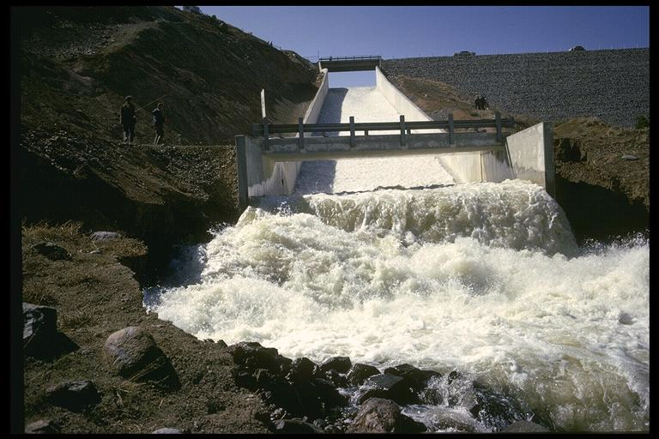
Dimensional Analysis and Similitude
CEE 331
December 18, 2012

Slide 2
Why?
“One does not want to have to show and relate the results for all possible velocities, for all possible geometries, for all possible roughnesses, and for all possible fluids...”
Wilfried Brutsaert in “Horton, Pipe Hydraulics, and the Atmospheric Boundary Layer.” in Bulletin of the American Meteorological Society. 1993.

Slide 3
On Scaling...
“...the writers feel that they would well deserve the flood of criticism which is ever threatening those venturous persons who presume to affirm that the same laws of Nature control the flow of water in the smallest pipes in the laboratory and in the largest supply mains running over hill and dale. In this paper it is aimed to present a few additional arguments which may serve to make such an affirmation appear a little less ridiculous than heretofore.”
Saph and Schoder, 1903

Slide 4
Why?
Suppose I want to build an irrigation canal, one that is bigger than anyone has ever built. How can I determine how big I have to make the canal to get the desired flow rate? Do I have to build a section of the canal and test it?
Suppose I build pumps. Do I have to test the performance of every pump for all speed, flow, fluid, and pressure combinations?

Slide 5
Dimensional Analysis
The case of Frictional Losses in Pipes (NYC)
Dimensions and Units
Π Theorem
Assemblage of Dimensionless Parameters
Dimensionless Parameters in Fluids
Model Studies and Similitude

Slide 6
Frictional Losses in Pipes circa 1900
Water distribution systems were being built and enlarged as cities grew rapidly
Design of the distribution systems required knowledge of the head loss in the pipes (The head loss would determine the maximum capacity of the system)
It was a simple observation that head loss in a straight pipe increased as the velocity increased (but head loss wasn’t proportional to velocity).

Slide 7
Two Opposing Theories
agrees with the “law of a falling body”
f varies with velocity and is different for different pipes
Fits the data well for any particular pipe
Every pipe has a different m and n.
What does g have to do with this anyway?
h_{l} is mechanical energy lost to thermal energy expressed as p.e.
“In fact, some engineers have been led to question whether or not water flows in a pipe according to any definite determinable laws whatsoever.”
Saph and Schoder, 1903

Slide 8
Research at Cornell!
Augustus Saph and Ernest Schoder under the direction of Professor Gardner Williams
Saph and Schoder had concluded that “there is practically no difference between a 2-in. and a 30-in. pipe.”
Conducted comprehensive experiments on a series of small pipes located in the basement of Lincoln Hall, (the principle building of the College of Civil Engineering)
Chose to analyze their data using ________

Slide 9
Saph and Schoder Conclusions
h_{l} is in ft/1000ft
V is in ft/s
d is in ft
Oops!!
Check units...
Oh, and by the way, there is a “critical velocity” below which this equation doesn’t work. The “critical velocity” varies with pipe diameter and with temperature.

Slide 10
The Buckingham Π Theorem
“in a physical problem including n quantities in which there are m dimensions, the quantities can be arranged into n-m independent dimensionless parameters”
We reduce the number of parameters we need to vary to characterize the problem!

Slide 11
Location under the influence of gravity
Location (x) is function of initial position (x₀), initial velocity (V₀), acceleration due to gravity (g), and time (t)
5 quantities, 2 dimensions (L and T): therefore 3 dimensionless groups
Choose x₀ and t as repeating parameters

Slide 12
Assemblage of Dimensionless Parameters
Several forces potentially act on a fluid
Sum of the forces = ma (the “inertial” force)
Inertial force is usually significant in fluids problems (except some very slow flows)
Nondimensionalize all other forces by creating a ratio with the inertial force
The magnitudes of the force ratios for a given problem indicate which forces govern

Slide 13
Forces on Fluids
Force parameter
Mass (inertia) ______
Viscosity ______
Gravitational ______
Surface Tension ______
Elasticity ______
Pressure ______
ρ
μ
g
σ
E
Δp
Dependent variable

Slide 14
Inertia as our Reference Force
F=ma
Fluids problems (except for statics) include a velocity (V), a dimension of flow (l), and a density (ρ)
Substitute V, l, ρ for the dimensions MLT
Substitute for the dimensions of specific force

Slide 15
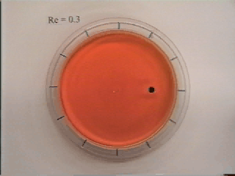
Viscous Force
What do I need to multiply viscosity by to obtain dimensions of force/volume?
Reynolds number

Slide 16
Gravitational Force
Froude number

Slide 17
Pressure Force
Pressure Coefficient

Slide 18
Dimensionless Parameters
Reynolds Number
Froude Number
Weber Number
Mach Number
Pressure
Drag Coefficients
Notes:
Waves
Droplet forming on the end of a tube
Sonic booms
Turbulent vs nonturbulent
Catapulted ice skaters on a finite size rink. Will they make it to the other side?

Slide 19
Problem solving approach
Identify relevant forces and any other relevant parameters
If inertia is a relevant force, than the non dimensional Re, Fr, W, M numbers can be used
If inertia isn’t relevant than create new non dimensional force numbers using the relevant forces
Create additional non dimensional terms based on geometry, velocity, or density if there are repeating parameters
If the problem uses different repeating variables then substitute (for example ωd instead of V)
Write the functional relationship

Slide 20
Example
The viscosity of a liquid can be determined by measuring the time for a sphere of diameter d to fall a distance L in a cylinder of diameter D. The technique only works if the Reynolds number is less than 1.

Slide 21
Solution
viscosity and gravity (buoyancy)
Inertia isn’t relevant
Substitute d/t for V

Slide 22
Application of Dimensionless Parameters
Pipe Flow
Pump characterization
Model Studies and Similitude
dams: spillways, turbines, tunnels
harbors
rivers
ships
...

Slide 23
Example: Pipe Flow
What are the important forces? ______, ______, ________. Therefore _________ number and ______________.
What are the important geometric parameters? _________________________
Create dimensionless geometric groups ______, ______
Write the functional relationship
Inertial
viscous
pressure
Reynolds
pressure coefficient
diameter, length, roughness height
l/D
ε/D

Slide 24
Example: Pipe Flow
How will the results of dimensional analysis guide our experiments to determine the relationships that govern pipe flow?
If we hold the other two dimensionless parameters constant and increase the length to diameter ratio, how will C_{p} change?
C_{p} proportional to l
f is friction factor

Slide 25
Frictional Losses in Straight Pipes
Capillary tube or 24 ft diameter tunnel
Where do you specify the fluid?
Where is “critical velocity”?
Each curve one geometry
Compare with real data!
Where is temperature?
At high Reynolds number curves are flat.
0.1
0.05
0.04
0.03
0.02
0.015
0.01
0.008
friction factor
0.006
0.004
laminar
0.002
0.001
0.0008
0.0004
0.0002
0.0001
0.01
0.00005
smooth
1E+03
1E+04
1E+05
1E+06
1E+07
1E+08
Re

Slide 26
What did we gain by using Dimensional Analysis?
Any consistent set of units will work
We don’t have to conduct an experiment on every single size and type of pipe at every velocity
Our results will even work for different fluids
Our results are universally applicable
We understand the influence of temperature

Slide 27
Model Studies and Similitude: Scaling Requirements
dynamic similitude
geometric similitude
all linear dimensions must be scaled identically
roughness must scale
kinematic similitude
same dynamic pressures at corresponding points ____________________________
streamlines must be geometrically similar
_______, __________, _________, and _________ numbers must be the same
Same pressure coefficient
Mach
Reynolds
Froude
Weber

Slide 28
Relaxed Similitude Requirements
Impossible to have all force ratios the same unless the model is the _____ ____ as the prototype
Need to determine which forces are important and attempt to keep those force ratios the same
same size

Slide 29
Similitude Examples
Open hydraulic structures
Ship’s resistance
Closed conduit
Hydraulic machinery

Slide 30
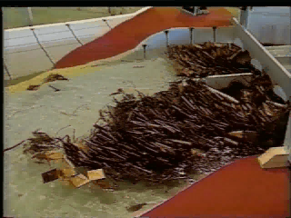
Scaling in Open Hydraulic Structures
Examples
spillways
channel transitions
weirs
Important Forces
inertial forces
gravity: from changes in water surface elevation
viscous forces (often small relative to inertial forces)
Minimum similitude requirements
geometric
Froude number
Cp is independent of Re

Slide 31
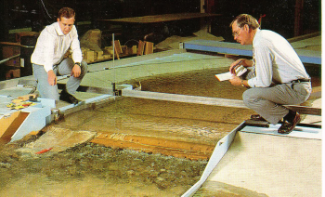
Froude similarity
Froude number the same in model and prototype
________________________
define length ratio (usually larger than 1)
velocity ratio
time ratio
discharge ratio
force ratio
1
difficult to change g
1
1

Slide 32
Example: Spillway Model
A 50 cm tall scale model of a proposed 50 m spillway is used to predict prototype flow conditions. If the design flood discharge over the spillway is 20,000 m³/s, what water flow rate should be tested in the model?
Re and roughness!

Slide 33
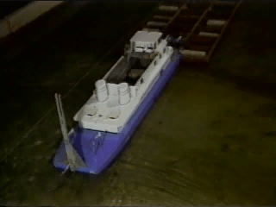
Ship’s Resistance
viscosity
Skin friction ___________
Wave drag (free surface effect) ________
Therefore we need ________ and ______ similarity
gravity
Reynolds
Froude
Notes:
When ocean-going sailing vessels were first replaced by steam-powered ships in the latter half of the nineteenth century, little was understood about the amount of power needed to drive these steam vessels. However, by 1872, William Froude had developed the method of using models to predict the power requirements of ocean vessels that is still in use today.
A ship moving over the surface of the ocean creates surface gravity waves which carry energy and momentum away from the ship. The wave system alters the pressure distribution on the ship's hull, producing a horizontal force , called the wave resistance. In addition, viscous shear stresses on the surface of the hull add to give an additional horizontal force , called the frictional resistance.

Slide 34
Reynolds and Froude Similarity?
Reynolds
Froude
1
1
1
Water is the only practical fluid
1
1
L_{r} = 1
Can’t have both Re and Fr similarity!

Slide 35
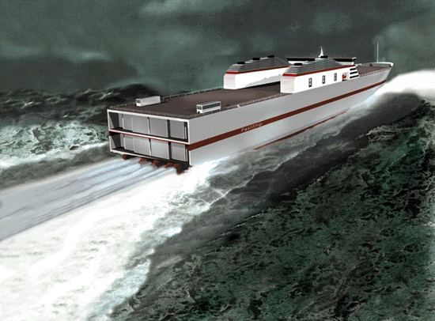
Ship’s Resistance
Can’t have both Reynolds and Froude similarity
Froude hypothesis: the two forms of drag are independent
Measure total drag on Ship
Use analytical methods to calculate the skin friction
Remainder is wave drag
analytical
empirical

Slide 36
Closed Conduit Incompressible Flow
Forces
__________
__________
If same fluid is used for model and prototype
VD must be the same
Results in high _________ in the model
High Reynolds number (Re) simplification
At high Re viscous forces are small relative to inertia and so Re isn’t important
viscosity
inertia
velocity

Slide 37
Example: Valve Coefficient
The pressure coefficient, , for a 600-mm-diameter valve is to be determined for 5 ºC water at a maximum velocity of 2.5 m/s. The model is a 60-mm-diameter valve operating with water at 5 ºC. What water velocity is needed?

Slide 38
Example: Valve Coefficient
Note: roughness height should scale to keep similar geometry!
Reynolds similarity
ν = 1.52 x 10⁻⁶ m²/s
Use the same fluid
V_{m} = 25 m/s

Slide 39
Example: Valve Coefficient (Reduce V_{m}?)
What could we do to reduce the velocity in the model and still get the same high Reynolds number?
Decrease kinematic viscosity
Use a different fluid
Use water at a higher temperature

Slide 40
Example: Valve Coefficient
Change model fluid to water at 80 ºC
ν_{m} = ______________
0.367 x 10⁻⁶ m²/s
1.52 x 10⁻⁶ m²/s
ν_{p} = ______________
V_{m} = 6 m/s

Slide 41
Approximate Similitude at High Reynolds Numbers
High Reynolds number means ______ forces are much greater than _______ forces
Pressure coefficient becomes independent of Re for high Re
inertial
viscous
Shear is still important!
Pressure drop still increases with velocity!

Slide 42
Pressure Coefficient for a Venturi Meter
10
C_{p}
1
1E+00
1E+01
1E+02
1E+03
1E+04
1E+05
1E+06
Similar to rough pipes in Moody diagram!
Re

Slide 43
Hydraulic Machinery: Pumps
Rotational speed of pump or turbine is an additional parameter
additional dimensionless parameter is the ratio of the rotational speed to the velocity of the water _________________________________
homologous units: velocity vectors scale _____
Now we can’t get same Reynolds Number!
Reynolds similarity requires
Scale effects
streamlines must be geometrically similar
As size decreases Re decreases and Cp varies with Re

Slide 44
Dimensional Analysis Summary
Dimensional analysis:
enables us to identify the important parameters in a problem
simplifies our experimental protocol (remember Saph and Schoder!)
does not tell us the coefficients or powers of the dimensionless groups (need to be determined from theory or experiments)
guides experimental work using small models to study large prototypes
end

Slide 45
NYC population
New Croton
Delaware
Croton
Catskill
10,000,000
population
1,000,000
100,000
1800
1850
1900
1950
2000
year

Slide 46
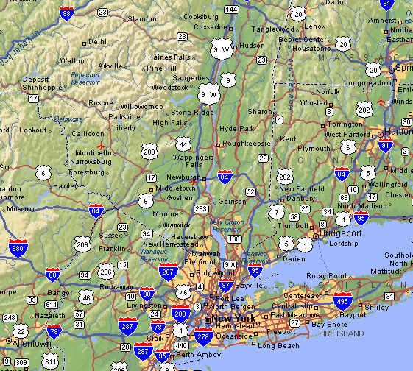
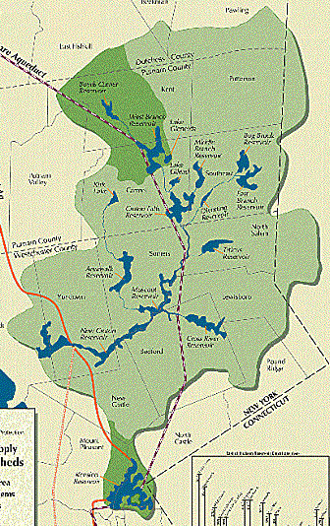
Supply Aqueducts and Tunnels
Catskill Aqueduct
Shandaken Tunnel
Delaware Tunnel
Neversink Tunnel
East Delaware tunnel
West Delaware tunnel

Slide 47
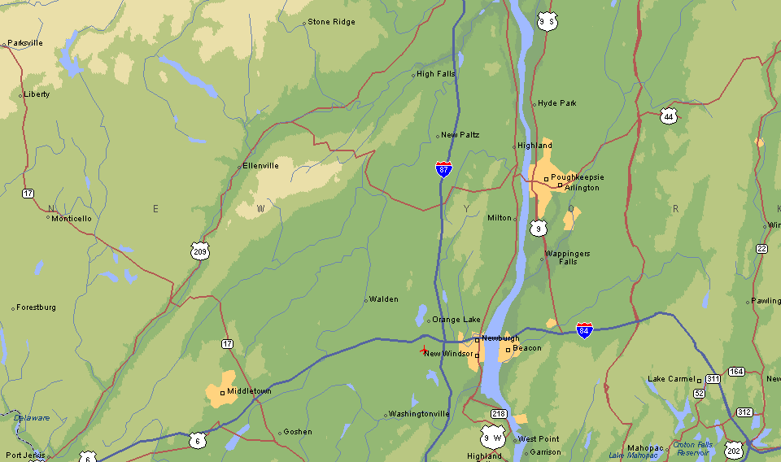
Delaware Aqueduct
Rondout Reservoir
10 km
West Branch
Reservoir

Slide 48
Flow Profile for Delaware Aqueduct
Rondout Reservoir
(EL. 256 m)
70.5 km
West Branch Reservoir
(EL. 153.4 m)
Sea Level
(Designed for 39 m³/s)
Hudson River crossing El. -183 m)

Slide 49
Ship’s Resistance: We aren’t done learning yet!
FASTSHIPS may well ferry cargo between the U.S. and Europe as soon as the year 2003. Thanks to an innovative hull design and high-powered propulsion system, FastShips can sail twice as fast as traditional freighters. As a result, valuable cargo should be able to cross the Atlantic Ocean in 4 days.

Slide 50

Port Model
A working scale model was used to eliminated danger to boaters from the "keeper roller" downstream from the diversion structure
http://ogee.hydlab.do.usbr.gov/hs/hs.html

Slide 51
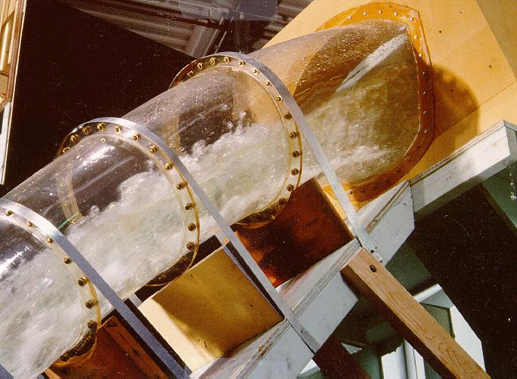
Hoover Dam Spillway
A 1:60 scale hydraulic model of the tunnel spillway at Hoover Dam for investigation of cavitation damage preventing air slots.
http://ogee.hydlab.do.usbr.gov/hs/hs.html

Slide 52
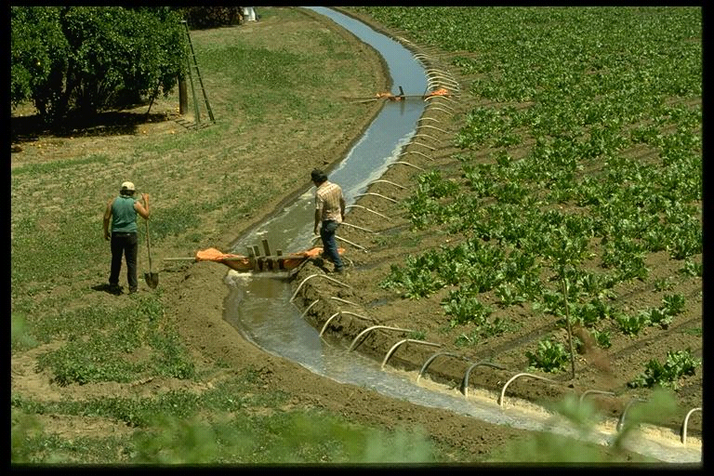
Irrigation Canal Controls
http://elib.cs.berkeley.edu/cypress.html

Slide 53
Spillways
Frenchman Dam and spillway Lahontan Region (6)

Slide 54
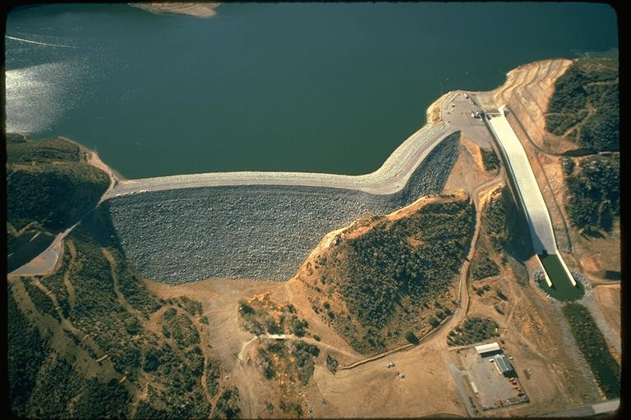
Dams
Dec 01, 1974 Cedar Springs Dam, spillway & Reservoir Santa Ana Region (8)

Slide 55
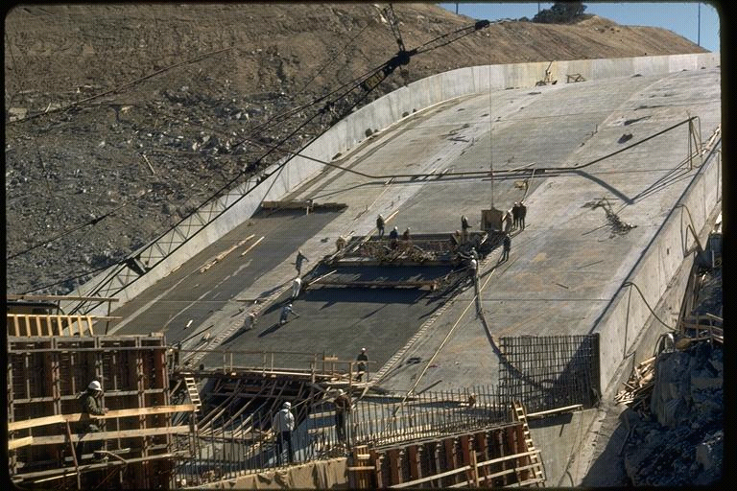
Spillway
Mar 01, 1971 Cedar Springs Spillway construction. Santa Ana Region (8)

Slide 56
Kinematic Viscosity
1.00E-03
1.00E-04
1.00E-05
kinematic viscosity 20C (m²/s)
1.00E-06
1.00E-07
water
air
mercury
kerosene
sae 10W
SAE 30
glycerine
ethyl alcohol
SAE 10W-30
carbon tetrachloride

Slide 57
Kinematic Viscosity of Water
/s)
2
2.0E-06
1.5E-06
1.0E-06
Kinematic Viscosity (m
5.0E-07
0.0E+00
0
20
40
60
80
100
Temperature (C)

